Slide 1
STAT7001 – Computing for Practical Statistics 2014 Lecture 3
Linear Models: Regression and Principal Component Analysis
Dr Franz J. Király

Slide 2
Course organization updates
First In-Course-Assessment
Downloadable via moodle (sheet and data set)
to be handed in not later than February 20
Group work
You should have liaised with your group partners by now
if they did not respond: go to workshops and find them in person
workshop instructors will offer assistance in locating them
Please inform us if you could not make contact by Saturday the 31st
Mock-ICA: report on the pulse data
Write a report on questions regarding the pulse data (workshop 2, ex.14)
Recommended as preparation/orientation for ICA
You can hand in a solution on-line via moodle/TurnitIn until February 6
Will be graded exactly as the ICA will be

Slide 3
Modelling Basics

Slide 4

The Scientific Method
qualitative version
Why did this apple fall from the tree?
Observation
Curious – all these apples falling from the trees without anybody telling them
Hypothesis
I hypothesize that this is a general principle – things unattached fall
That is, if I try to drop various things out of my living room window, they will fall into the garden
Prediction
Experiment
I. Newton’s lab protocol, July 3rd, 1648. The experiment has been a great success. Confirmed hypothesis for a variety of food articles and furniture listed in Appendix C.
Conclusion: Hypothesis valid for samples that don’t move. Further experimentation needed on live specimens.

Slide 5
The Scientific Method
quantative version
with Statistics!
Why did this apple fall from the tree?
Observation
Drop height/ strange British length unit
1.0 | 3.9 | 9.1 | 16.2 | 24.9
.1 | .2 | .3 | .4 | .5
Drop time/ weird British time unit
Hypothesis
Looks like height = 100 time² + residual
(I ran polynomial regression in R)
I hypothesize that this will be the case for any other height/time pair.
Prediction
Experiment
Drop height/ strange British length unit
35.9 | 49.2 | 64.5 | 80.5 | 101
.6 | .7 | .8 | .9 | 1.0
Average relative error = 1%
Drop time/ weird British time unit
A good fit!
Conclusion: Hypothesis confirmed. I think the reason might be an unspecified invisible force. Further investigation is needed. Increase height? Live specimens?

Slide 6
What is a scientific model?
A qualitative or quantitative statement (on the measurements)
which allows to make predictions
that can be confirmed or refuted in an experiment.
Qualitative example: things unattached fall to the ground
Qualitative non-example: apples are beautiful
Quantitative example: height = 100 time² + residual/noise
Quantitative non-example: the result correlates with the (unmeasurable) Orgone energy in the room
Models need to be checked in an experiment
Either: use is purely explorative, and that is clearly said
Or, better: model is trained on part of the data („training sample“, rule-of-thumb 80%)
prediction error is estimated on test subset („test data“, rule-of-thumb 20%)
Never train models on the test sample!
If you repeat train/test to optimize the model, do that inside the training set.
More on model validation next week in lecture 4.

Slide 7
Discriminative and generative models
Discriminative models:
model dependence/conditionality of variables
Example: how pulse is determined/explained by weight and height
Mathematically: by modelling conditional P(y|x)
no strong assumption on x is needed
„y depends on x“
But: dependence is a strong assumption
Generative models:
model relation/association of variables
Example: how weight and height relate/vary with each other
Mathematically: by modelling joint probability P(x,y)
no strong assumption on dependence is needed
„x and y relate“
But: both x and y must be modelled
Both are fine for description and prediction, but be clear about what you do

Slide 8
How R models models
Specific object class for models:
formula
describes the variables in the model
usually used as part of model fitting command
example from lecture 2:
boxplot(pulseafter~ran*sex)
General syntax
targetvariable~ …
a formula in variable/column names
~
separates dependent variable (left) and model variables (right)
(left side only in discriminative models, e.g. regression)
+
separates different variables
not the sum!
weight+height
is model having weight and height
:
creates a cross-variable
e.g.
weight:height
*
adds variables and cross-terms
weight*height
equals
weight+height+weight:height
type
help(formula)
to read on
^
I(…)
%in%
–
0
1

Slide 9
Linear Regression

Slide 10



What is Linear Regression?
Linear estimation of dependence between continuous variables
e.g. weight
e.g. pulse

Slide 11


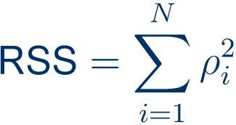

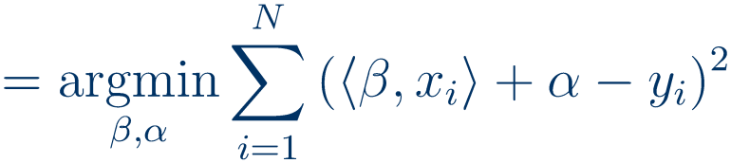



Ordinary Least Squares Regression
in other words:
where
and

Slide 12



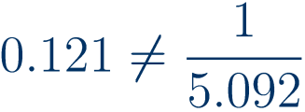
Ordinary Least Squares Regression in R
To learn a least squares linear regression model:
lm(formula=weight~height,data=pulsedata)
lm(formula=height~weight, data=pulsedata)
what is the problem?
No.1 height does not really „depend“ on weight or the other way
discriminative learning is problematic for these two variables
No.2 nothing is said here about the quality of the fit
No.3 the fit is least-squares onto the target variable
therefore the result depends which is which!

Slide 13
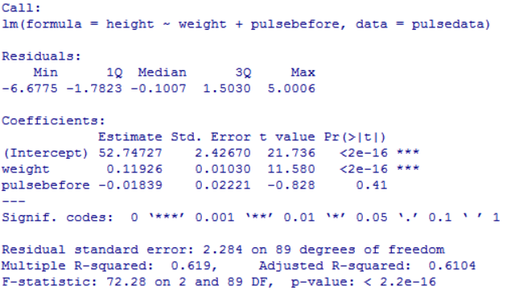



lm returns an object of class lm („linear model“)
pulsedata.lmhtwt<-lm(data=pulsedata, formula=height~weight+pulsebefore)
summary(pulsedata.lmhtwt)
(please think about why this model is not a good one)
residual quartiles
look for skewness & outliers
estimated standard error
of the coefficient estimate
t-statistic and significance level
Null = coefficient is zero
not goodness of model!
residual standard error
Adjusted R²
R²-statistic
Modell fits well if R² close to 1, badly if close to 0
F-statistic
R² does not describe goodness of prediction!
Null = all coefficients are zero
Do not base your reasoning only on R²-statistic!
Goodness of prediction is measured by out-of-sample-error!

Slide 14
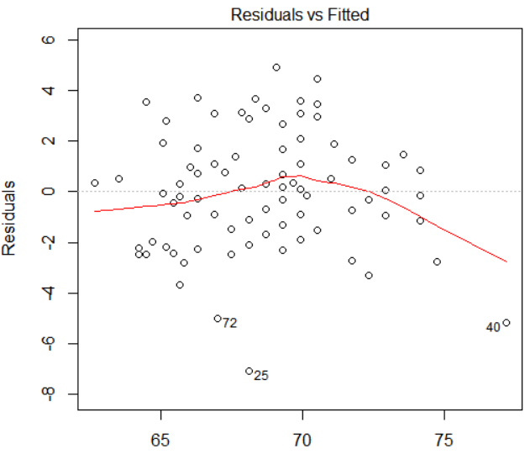

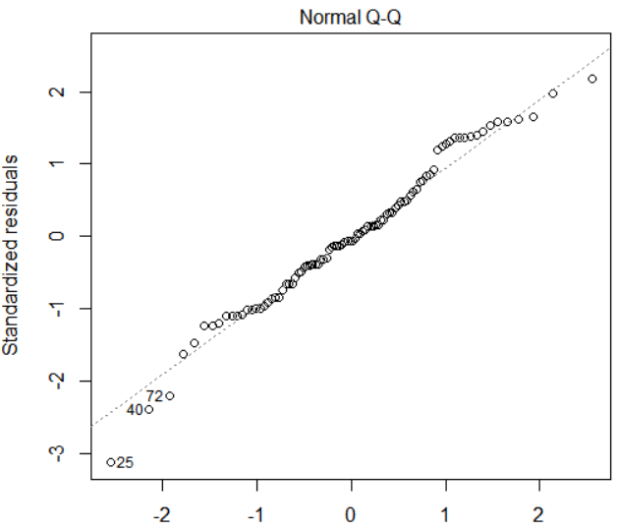

Diagnostic Plots for OLS
plot(pulsedata.lmhtwt)
returns four plots
access them one-by-one through
plot(pulsedata.lmhtwt, which = 1:2)
get them in one single plot by
par(mfrow=c(2,2))
outliers
1. Residual plot: look for structure in residuals
plot(pulsedata.lmhtwt, which = 1)
plots residuals vs fitted values
perfect fit: all points are on x-axis
?
Gaussian noise: vertical band, red curve is the x-axis
2. QQ-plot: look for skewness and non-normality
plot(pulsedata.lmhtwt, which = 2)
plots residual quantiles vs Gauss-Q from mean/var
Standardized residual = residual / ist st.deviation
outliers
Gaussian noise: straight line
both: look for outliers and residual structure

Slide 15
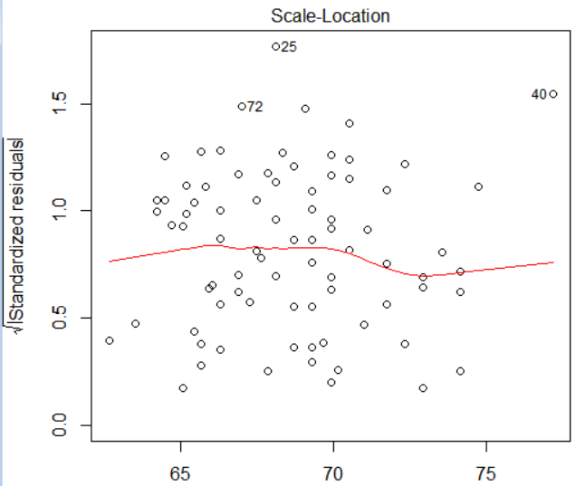


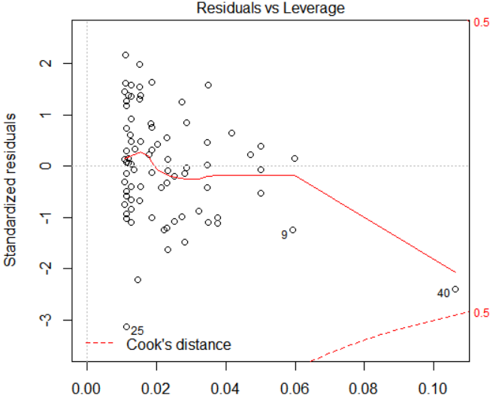


3. Standardized residual plot
plot(pulsedata.lmhtwt, which = 3)
plots standardized residuals vs fitted values
Qualitatively similar to 1. Cave: square root of abs.value
When different: compare! Outliers? Shape?
4. Leverage plot and Cook‘s distance
plot(pulsedata.lmhtwt, which = 4)
plots standardized residuals vs leverage
„hat matrix“
measures strength of impact on the result
Cook‘s distance (dashed red curve):
overall effect when deleting observation
Leverage = impact when data point is changed Cook‘s distance = impact when point is removed
Data point with high leverage and Cook‘s distance might be a measurement error – but not necessarily!
Check.

Slide 16
Obtain derived statistics from lm model
model coefficients:
pulsedata.lmhtwt$coefficients
Residuals:
pulsedata.lmhtwt$residuals
fitted values:
pulsedata.lmhtwt$fitted.values
leverages/ hat values:
hatvalues(pulsedata.lmhtwt)
Influences/ Cook‘s distances:
influence(pulsedata.lmhtwt)
Understand the mathematics behind the different statistics!
To assess prediction strength: Test your model on unseen data!
trainsample <- sample(nrow(pulsedata), size = trainsize)
lmhtwt <- lm(height~weight,data = pulsedata[trainsample,])
prediction <- predict(lmhtwt, pulsedata[-trainsample,])
summary(prediction-pulsedata[-trainsample,"height"])
More about predictive validation in lectures 4 and 7.

Slide 17
Principal Component Analysis

Slide 18



What is Principal Component Analysis?
Linear estimation of relation between continuous variables
e.g. weight x height
e.g. (1 kg, 1 cm)

Slide 19


Principal Component Analysis
with biggest eigenvalue

Slide 20
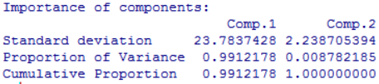
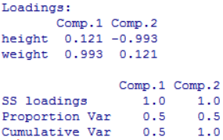
princomp returns a list of tables
pulsedata.pcahtwt <- princomp(formula = ~height+weight, data=pulsedata)
summary(pulsedata.pcahtwt)
Standard deviation of components
Fraction of the total variance in this component
principal components are obtained via
Fraction of the total variance up to this component
pulsedata.pcahtwt$loadings
components are normalized
access the vectors by
SS/Var of the loadings matrix
pulsedata.pcahtwt$loadings[,1]
not of the projected data!
(is of class loadings, similar to matrix)
What do the principal components tell you?
First principal vector: direction of highest variance (height,weight) = (0.121,0.993)
with(pulsedata.pcahtwt,loadings[2,1]/loadings[1,1])
with(pulsedata.pcahtwt,loadings[1,1]/loadings[2,1])
compare coefficients from regression: 0.121 and 5.092
k-th principal vector: orthogonal direction of next highest variance

Slide 21

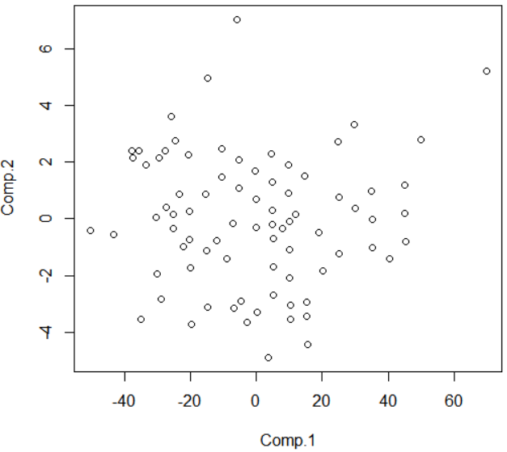
Principal scores and Diagnostic Plots
Principal scores = projections of data on principal components
„the data when p.components = coordinate system“
pulsedata.pcahtwt$scores
Exploration: Plot the data in the principal scores
Look first at the first two to four components
Very useful if you have lots of variables
plot(pulsedata.pcahtwt$scores[,1:2])
Look for same things as in usual scatterplot
Diagnostic: Residual plots
sum of lower variance scores = residuals
(for 2 components: same as above)
plot lower variance principal components versus higher components
In general, plot one-component-score vs norm of other scores
both: look for outliers and residual structure; which components have outliers?
Generally: include meaningful scores for the data in further analyses
e.g. single-component exploration, multiple components, prediction/regression, etc

Slide 22
OLS
PCA
Discriminative
Generative
fits a linear dependence
estimates linear relations/components
Dependent vs independent variables
all variables are treated equally
MLE for Gaussian noise on dependent variables
MLE for Gaussian noise on complete observation
Prediction of dependent variables
Prediction of variance structure
Use to study dependence, or causal relation
Use to study overall behavior without assuming dependence
Both models can be used for descriptive and predictive analyses.
But always be clear on what you are doing!

Slide 23
Next Week: Principles of Data Analysis
Scientific and statistical validation
The data analysis workflow
Working with multiple data sets
How to write a statistical report

Slide 24
Week 3 Learning Objectives
Simple Modelling in R
Understand syntax of R models
Simple and interaction terms, intercept term
OLS and PCA
How to perform regression on specified model
Summary parameters and diagnostic plots
Identifying features and problems:
Non-linearity, outliers, variable interaction
Identifying principal components with PCA
Regression vs PCA, Generative vs Discriminative
Try it out on actual data (pulse, electricity)

